Slide 1
What is The Effect of The Earth’s Temperature on Cyclonic Storms
By: Al Haque

Slide 2


Context:
Rising Average Global Temperature is associated with widespread changes in the weather patterns.
Studies shows that events like heat waves and large storms are likely to become more frequent and intense with human induced climate change

Slide 3

Why Does It Matter?
-Long terms changes in climate can directly or indirectly affect many aspects of society
-Warmer weathers can increase the costs of air conditioning bills and promote the spread of certain diseases like Lyme disease
- Frequent and Intense Heat events can cause events like widespread wildfires to rising flood levels that can increase the risk of catastrophic flooding

Slide 4
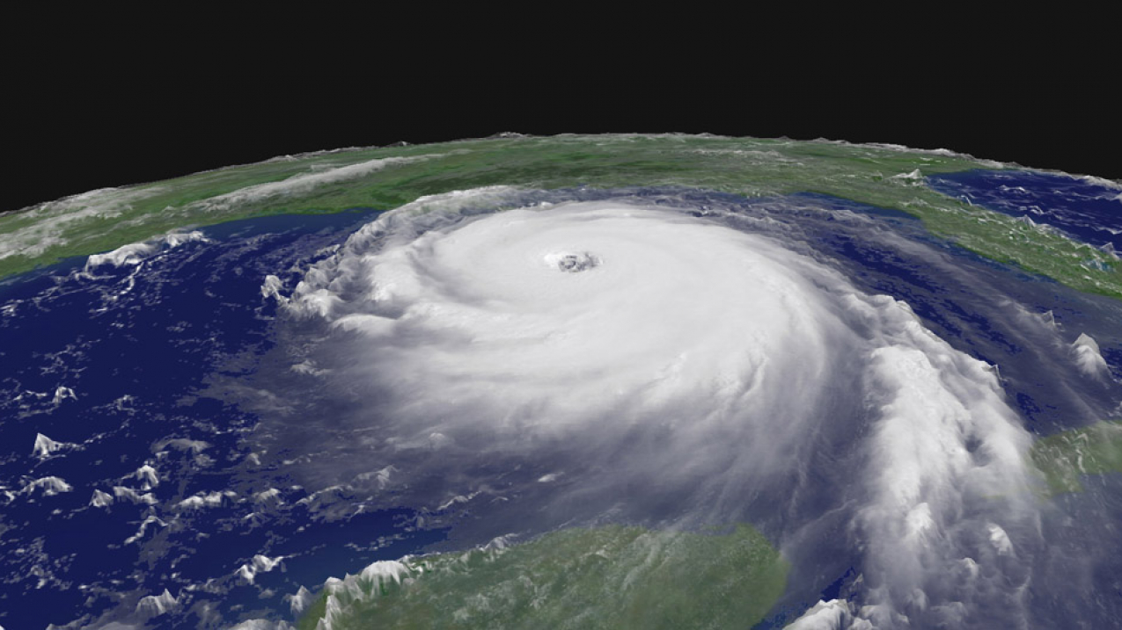
Cyclonic Storms Background:
Hurricanes, Tropical Storms and other Rotating Storms fall into a general category called cyclones
The effects of cyclones on society are tremendous ,at sea, storms disrupt and endanger shipping traffic, on land they can cause severe property damages, loss of life and flooding

Slide 5
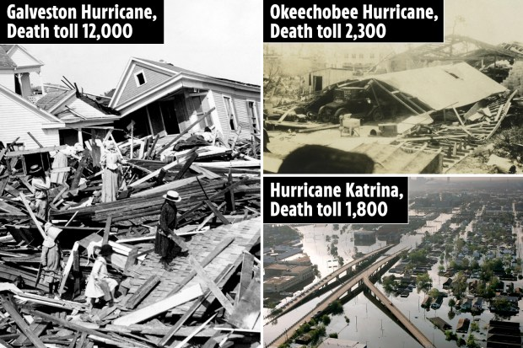

Slide 6
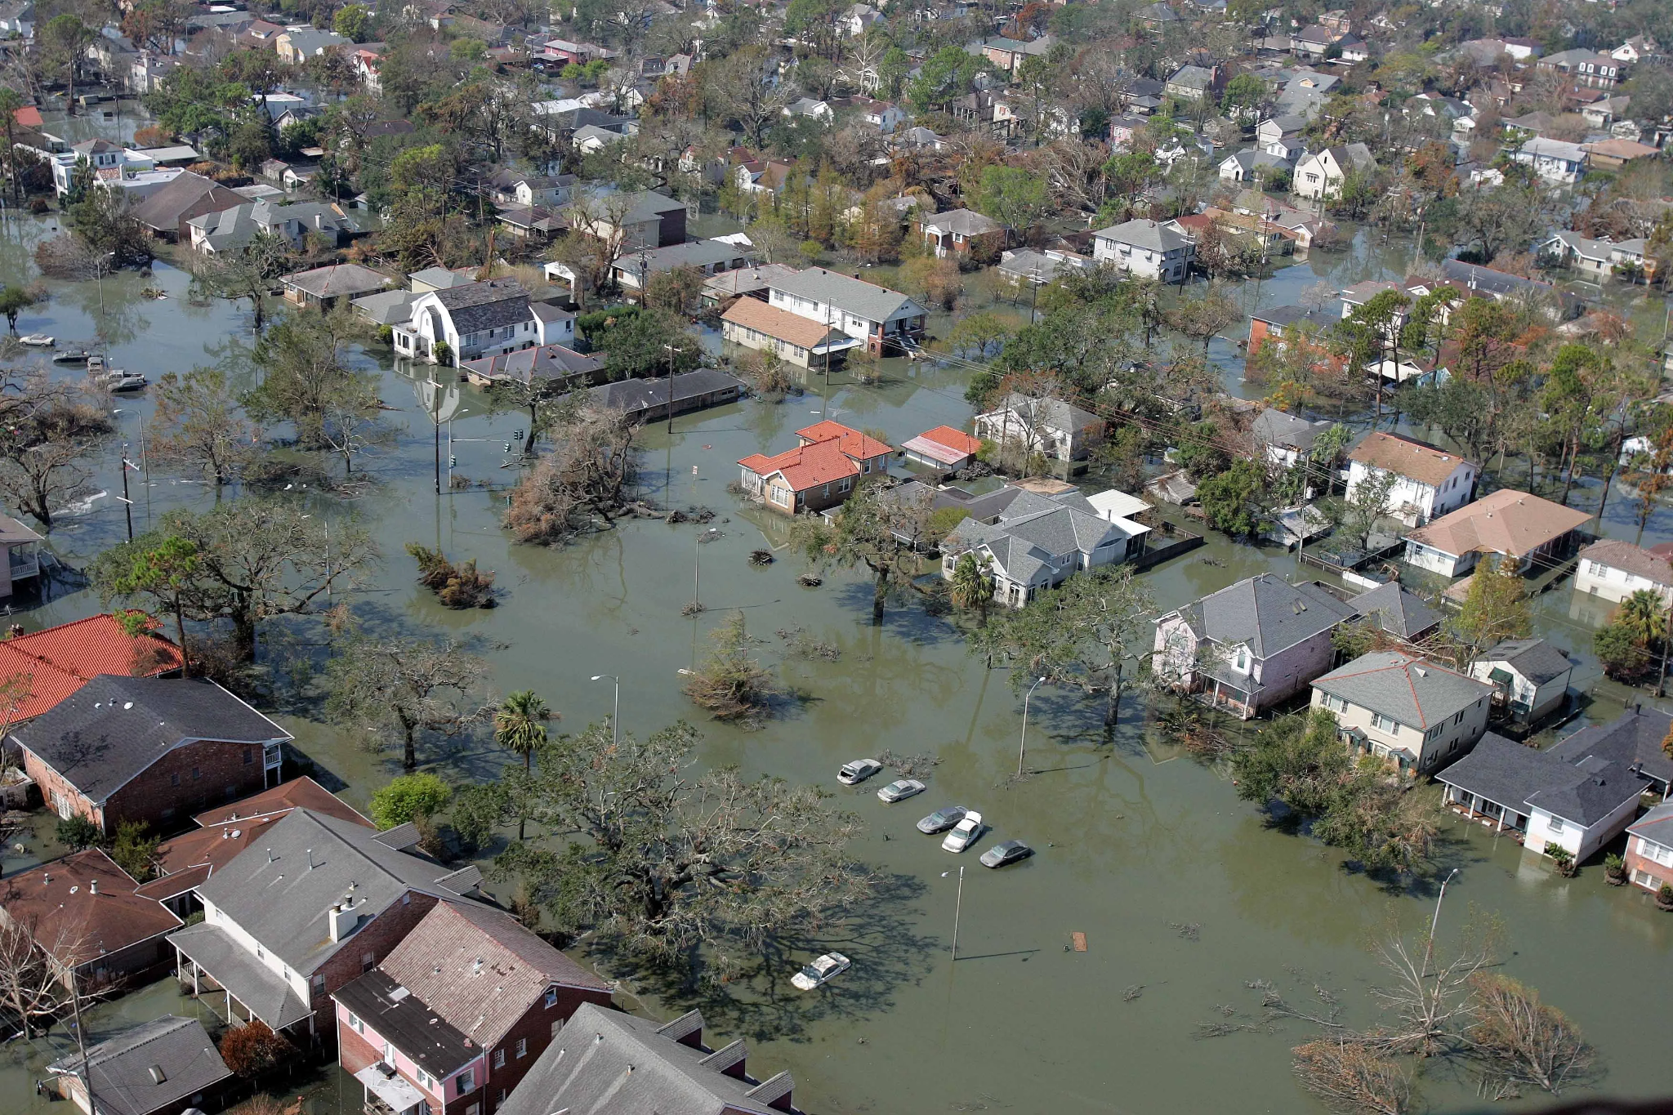
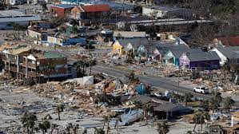
Even More Pics

Slide 7
Impact of Climate Change on Cyclones
Climate change is expected to affect cyclones by increasing temperature which is a key factor in the creation of cyclone formation and behavior
A warming climate is expected to impact sea level rise, storm surge and tropical cyclone intensity
The U.S Global Change Research Program projects that tropical cyclones will become more intense over the course of the 21st century with higher wind speeds and intense storms
Source: https://www.goes-r.gov/featureStories/monitoringHurricanes.html

Slide 8
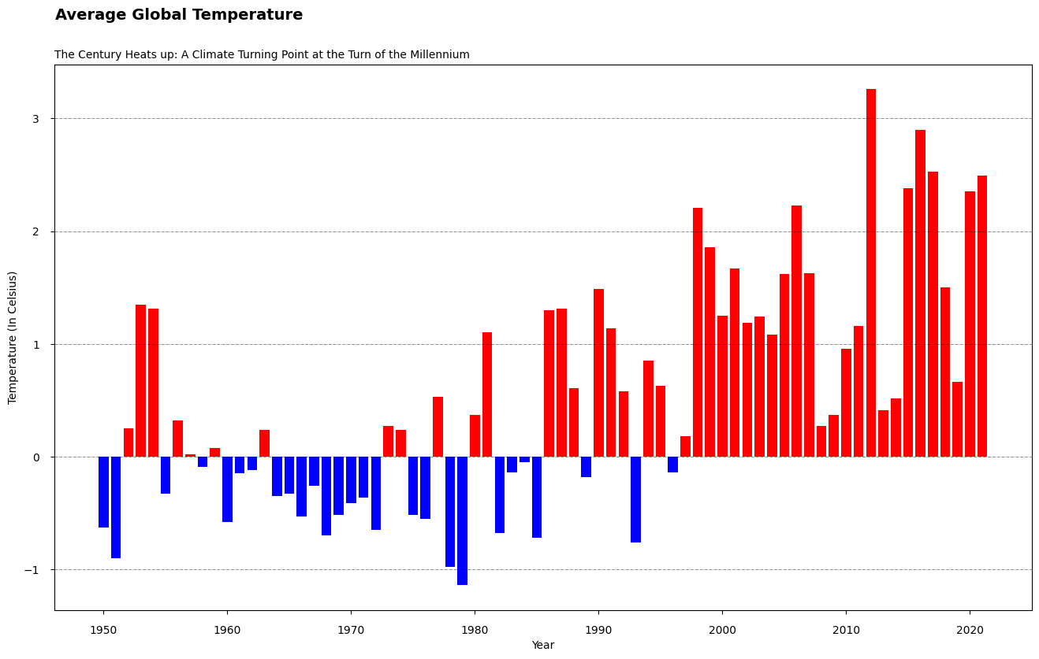
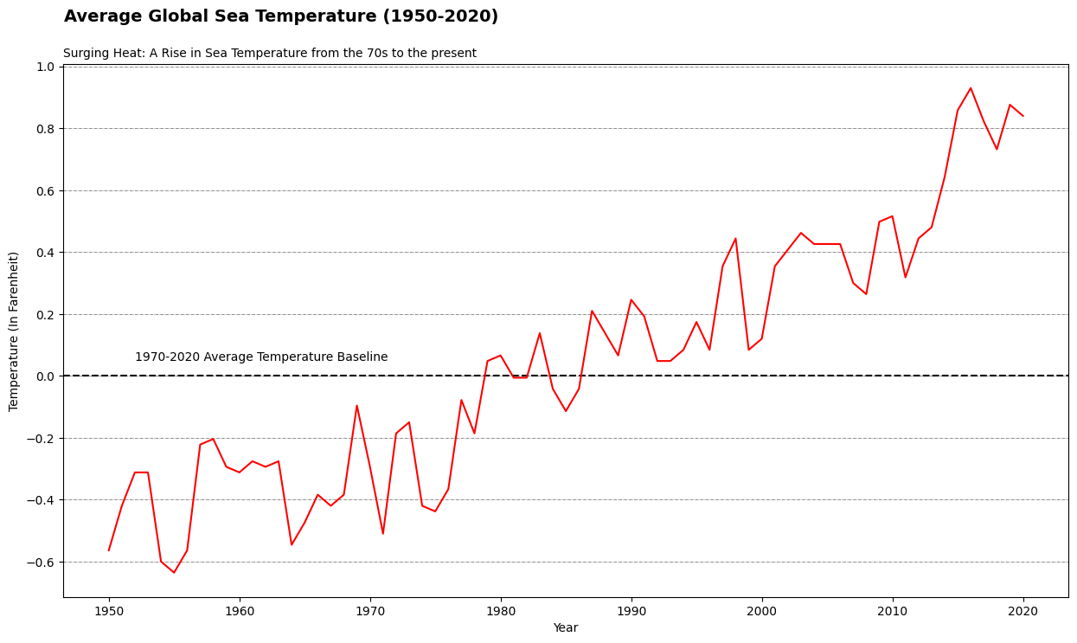
Warmer air creates warmer sea surface temperatures, which provide more energy for storms to strengthen. Sea Surface Temperature can indicate how strong a hurricane can become

Slide 9
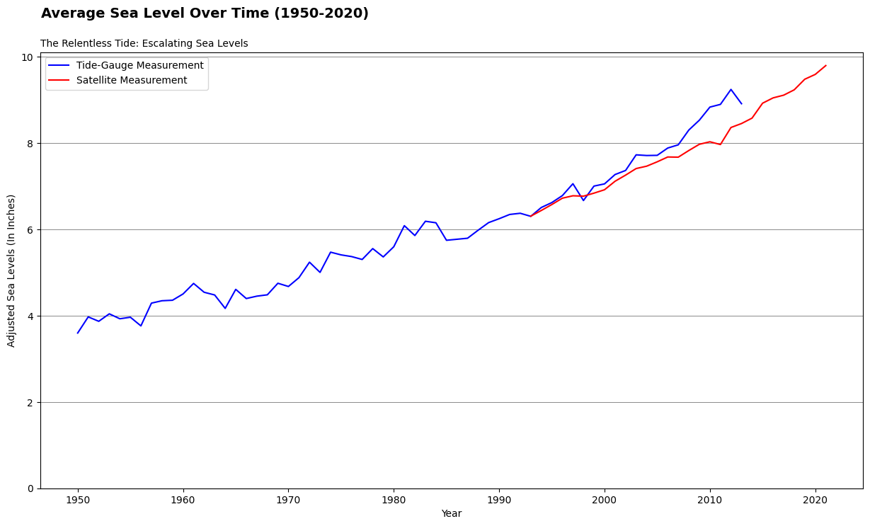
Sea level rise is expected to cause higher storm surge levels when a tropical cyclone does occur, and tropical cyclone rainfall rates will likely increase.

Slide 10
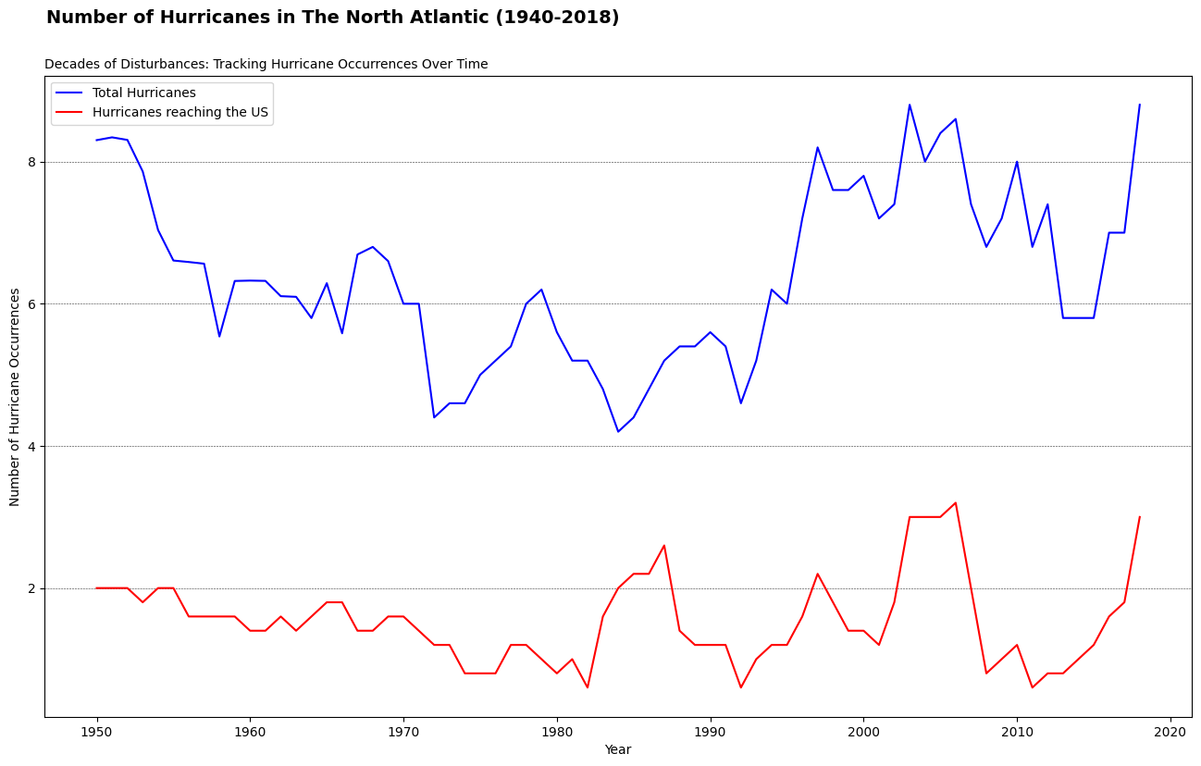
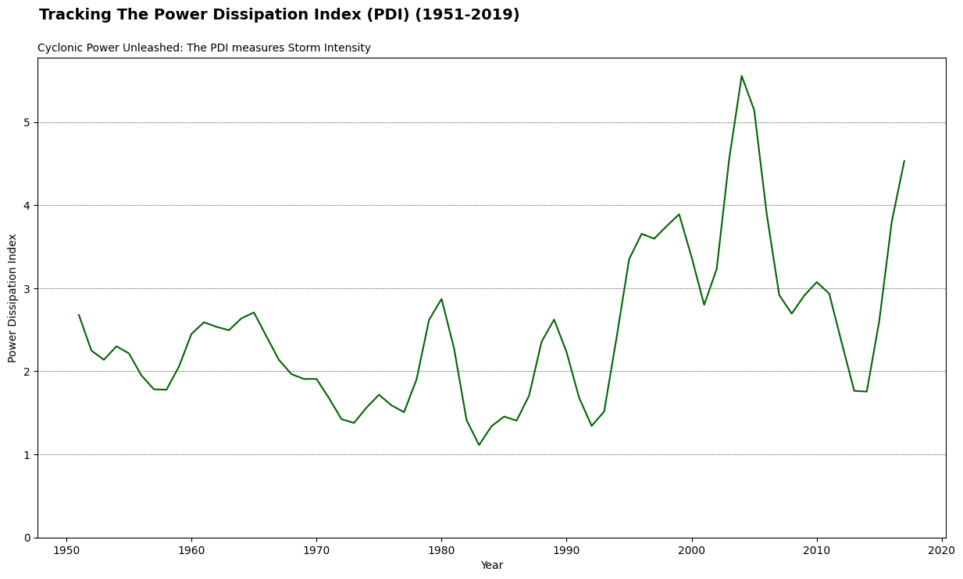
The intensity of the tropical cyclones are expected to increase globally, with a greater amount of these hurricanes reaching category 4 or 5, The Power Dissipation Index tracks measurements of wind speed with an emphasis on Storm Intensity. The number of Hurricanes have increased at the start of the century

Slide 11
To recount:
Warmer Temperature Lead to Stronger Hurricanes, Sea Surface Temperature can tell us how strong a hurricane can get
Sea Level Rises causes Stronger Storm Surges which can lead to increased storm rates and lead to more hurricane frequencies
Number of Hurricanes have increased at the turn of the century
Intensity of Global Hurricanes are expected to rise globally, with a greater proportion of hurricanes reaching category 4 or 5
The Power Dissipation Index measures an increase of hurricane intensity with category 4 or 5 hurricanes on the rise

Slide 12
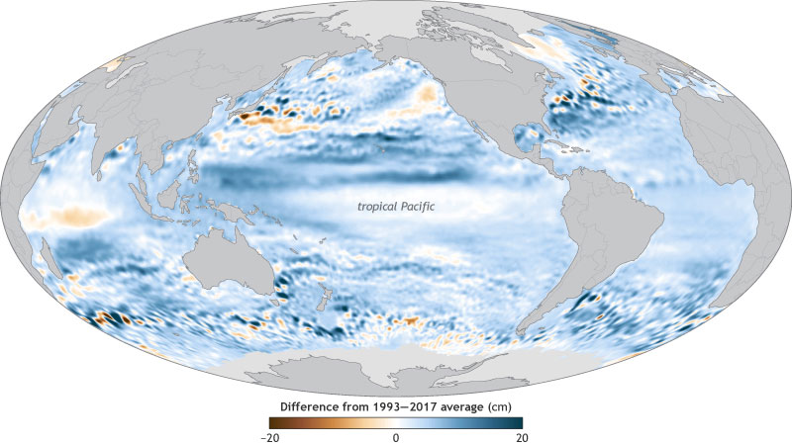
https://www.goes-r.gov/featureStories/monitoringHurricanes.html (Picture From Article.)
A global map showcasing sea levels in 2017 are higher (blue) or lower (red) than the 1993-2017 average. In 2017 global sea levels was three inches higher than the 1993 average

Slide 13
Sources:
I have sourced my data from The US government EPA website which tracks all indicators of Climate Change and the Hurricane Research Division.
https://www.epa.gov/climate-indicators/climate-change-indicators-sea-level (Sea Level)
https://www.epa.gov/climate-indicators/climate-change-indicators-sea-surface-temperature (Sea Surface Temperature)
https://www.aoml.noaa.gov/hrd/hurdat/comparison_table.html (Hurricane Tracking Data)
https://www.epa.gov/climate-indicators/climate-change-indicators-us-and-global-temperature (Global Temperature)
https://www.epa.gov/climate-indicators/climate-change-indicators-tropical-cyclone-activity (Power Dissipation Index Activity..)
https://www.goes-r.gov/featureStories/monitoringHurricanes.html (NASA article on Hurricanes for Information)

Slide 14



